Slide 1


Final Exam – 90 Mins – Week 13
The final exam will only cover material in these powerpoints
DO NOT study the material in the first half as it will NOT appear on the final exam.

Slide 2
Reminders
DOWNLOAD the PowerPoints
I put a lot of information in the “notes” section. This lets us have less text heavy slides and more diagrams/images
Any slides with green background (like this one)are for your reference only and will not appear as questions on any tests or quizzes.
Sources/links in notes sections do not need to be studied, but they may be helpful/useful for students who wish to pursue a career in networking or those who want some additional reading

Slide 3
Reminders
I won’t ask you to memorize acronyms (I won’t say “what do the letters of FTP stand for”, I instead will ask “how does FTP work” or “why is FTP important”)
This course involves a lot of theory. See the end of these PowerPoints (slide 136 onwards) for some sample questions if you’re having trouble studying for the quizzes/midterm
Refer to SLATE calendar for any appropriate due dates for assignments/activities/tests

Slide 4
What do I do if I miss a deadline?
Sheridan policy requires you to notify me, in advance where possible, for an extension.
If this is not possible, you must email me supporting documentation (e.g. death notice, doctor’s note, etc…) explaining why you could not make the deadline - within 24 hours of the due date
You will then select a new due date. This becomes binding once selected and I cannot provide a second extension
If you do not follow this protocol you will receive 0.
If you submit an assignment late it is 10% off per day late and 0 after 3 days (the drop box will close). SLATE calendar will indicate the day/time of the quiz/assignment.
If you miss a test you must write in the assessment centre ($25)
Please note that work/family/minor illness are not usually valid reasons for an accommodation
Book on the assessment centre’s website (https://www.sheridancollege.ca/admissions/assessment-centre)
Once booked you will receive an email. Forward it to me.
Notes:
https://tech.fast.sheridanc.on.ca/r/ac_academic_procedures_for_evaluations.pdf

Slide 5
Grading Policy
Only YOU can pass this course
The work you do will impact the grade that you earn.
Grades are earned, not given.
If you email me at the end of the semester to ask me to “give you” a grade I will refer you to this notice
There are no makeup tests
There are no “grace marks”
Notes:
I know this might seem harsh but the idea is that grading should be transparent. If you do a certain amount of work you should receive a grade for the work that you do – and if another student does the same amount of work they should receive the same grade.
Asking me to give you grades you did not earn will not accomplish anything and I want to be upfront about it now.

Slide 6


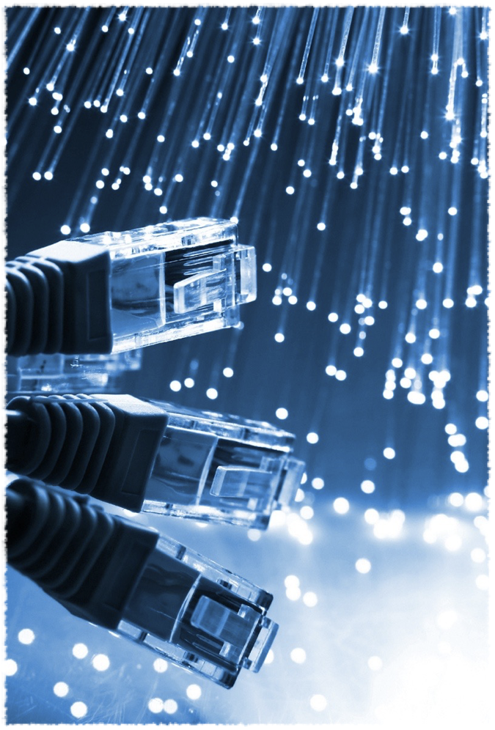
Week 08 Network Layer: Basics of Packet Forwarding
Notes:
Learning Goals
Define the functions of the network layer
Discuss the concept of packet switching
Calculate subnets and subnet masks
Work with CIDR notation to find subnets and subnet masks
Describe IPv4 and IPv6 as well as the concept of classful addresses
Describe the process of DHCP and NAT

Slide 7
Attendance Question
Every week I will have a silly question (usually) as a way to get to know everyone.
These are not for marks but instead a way for me to get to know everyone!
If you have a different name that you prefer I use, or if I pronounce your name incorrectly – let me know!
Week 08:
Stop
Start Continue

Slide 8
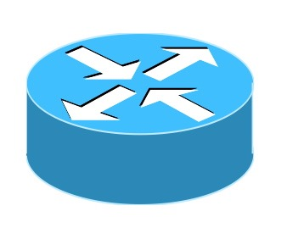

Duties of the Network Layer
Packetizing
Routing and forwarding
Carry a payload from source to destination without changing the contents
I wrote a song about encapsulation…
Its actually more of a wrap.
Notes:
Packetizing
(encapsulating and decapsulating the data)
Carrying a payload from source to destination without changing it
(think of the post service…you wouldn’t want them to read and change your mail!)
Routing and forwarding (see next two slides)

Slide 9

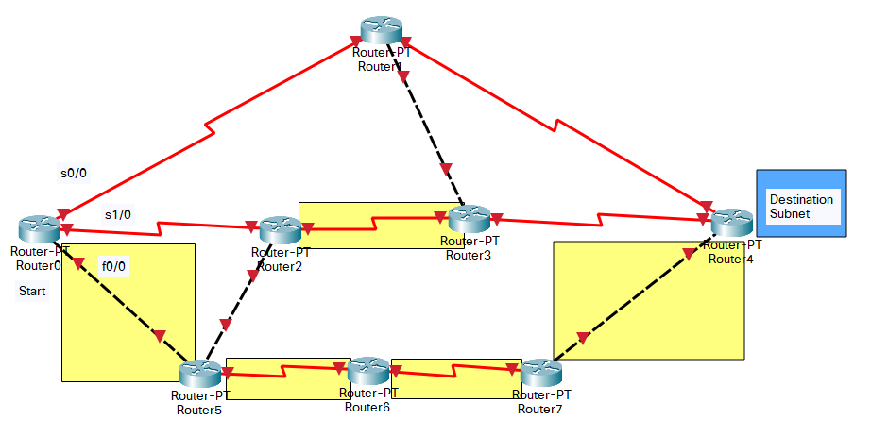
What is Routing? – RIP
Routing is using a routing protocol in order to find the “best” path. Once discovered that information is entered in the routing table
RIP uses hop count (hops are the number of routers you pass through on the way to the destination)
How many hops?
How many hops?
How many hops?
Notes:
RIP (Routing information protocol)
Uses hop count
A hop is a router you have to pass through (both enter and exit)
I wont expect you to find the shortest path like this on a test

Slide 10
What is Routing? – OSPF and EIGRP
OSPF and EIGRP use path weight – a mathematical algorithm to assign a number to every path based on their throughput, bandwidth, latency and other factors. Choose the path with the least path weight
Imagine
Yellow = Fibre (path weight = 1)
Nothing = Ethernet (path weight = 3)
3
3
3
1
3
1
1
1
1
Notes:
OSPF (Open Shortest Path First)
- Uses bandwidth/latency/throughput and other factors to calculate the path weight. We then take the path with the shortest weight
- Uses Dijkstra’s algorithm
EIGRP (Enhanced Interior Gateway Routing Protocol)
- Uses bandwidth/latency/throughput and other factors to calculate the path weight. We then take the path with the shortest weight
- Cisco routers only
I wont expect you to find the shortest path like this on a test

Slide 11


What is Routing? – Metaphor
Scenario 1
Scenario 2
Bus 1 arrives in 50 mins with 1 bus transfer
Bus 2 arrives in 1 hour and 5 mins with no transfers
Bus 1 arrives in 50 mins with 1 bus transfer
Bus 2 arrives in 3 hours with no transfers
Which would you choose?
Which option would RIP choose?
Which would you choose?
Which option would RIP choose
Notes:
In both scenarios RIP will select the 2nd bus (since there are fewer transfers – a metaphor for hops here)
OSPF and EIGRP will select the first bus which is especially relevant for the second scenario

Slide 12
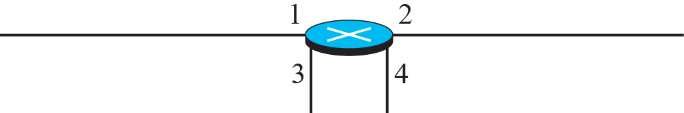
What is forwarding?
Forwarding occurs after the process of routing. The router attempts to find what to do with a destination
What happens if the router receives a message destined for subnet B?
Forwarding Table
Interface | Subnet
1 | D
2 | B
3 | C
4 | A
Forwarding process
B
Data
Notes:
The router will forward the message out interface 2. The router uses a process called ANDing to determine what subnet the message is destined for – more on this a little bit later
Routing and Forwarding
Routing is the process of finding the best path
Forwarding is the act of using that information in the table to forward the packet out of the right interface

Slide 13
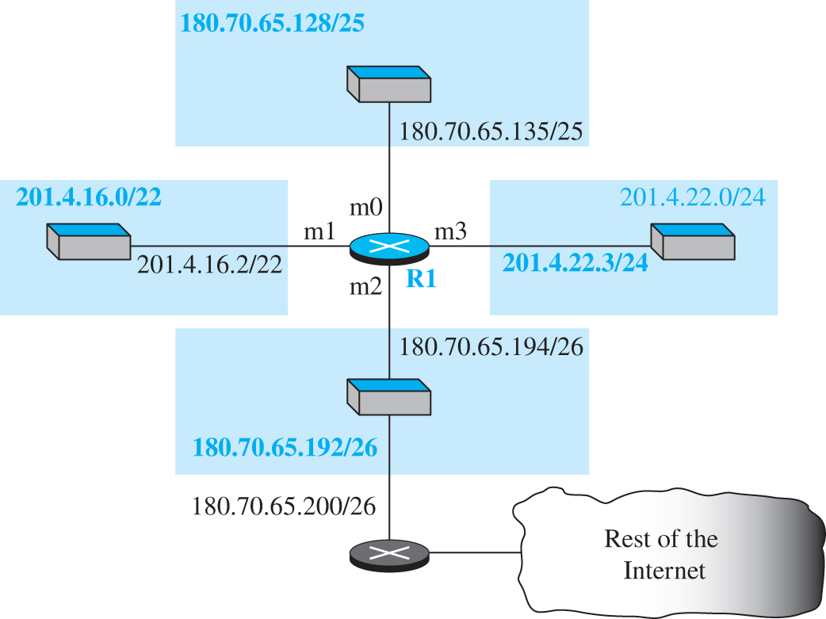
What is forwarding?
What would the routing/forwarding table look like for R1?
Network address/mask | Interface
180.70.65.192/26 | m2
180.70.65.128/25 | m0
201.4.22.0/24 | m3
201.4.16.0/22 | m1
0.0.0.0 /0 | m2

Slide 14

Routing VS Forwarding
Although routing and forwarding are two separate actions the routing table becomes the forwarding table (as that table is what we use to make our forwarding decisions)
I won’t expect you to calculate the shortest path on an exam but I will expect you to know 1 fact about each of the routing protocols we discussed. RIP, OSPF, and EIGRP.

Slide 15

DHCP
DHCP: How does my PC get an IP?
Sure! What about IP#5 ?
While you decide no one else can use it!
Great! Use IP #5 as long as you want, I’ll reclaim it if you stop using it
DHCP Server 2
IP#2
IP#4
IP#6
IP#8
.
.
.
DHCP Server 1
IP#1
IP#3
IP#5
IP#7
.
.
.
IP#2 is much better! No one else can use it either!
I’ll find someone else to appreciate you IP#2
Hey, I just joined the network and I need an IP address
List the 4 steps in the DHCP leasing process
IP #5 got here first! That’s my new IP
Notes:
Apologies, due to the animations this slide is a bit cluttered, probably best to play it to see things properly.
DHCP automatically assigns an IP address when you join a network. This animation goes through the process
It Is not necessary to have multiple DHCP servers but for larger organizations this animation depicts one method – you might also clone the DHCP server and assign a load balancer with only a single IP address
In the case of multiple DHCP servers it is imperative that the list of IPs they have are different (that way two devices won’t be offered the same available IP)
Steps in the DHCP leasing process:
A connected device requests an IP address via a DHCP broadcast
The DHCP server (or servers) each offer 1 available IP. While this offer is in play, no one else will be offered that same IP address
The PC will accept the first IP it receives and make another broadcast stating it is accepting that IP address
Any unused IPs (offers from other DHCP servers) will then be available for other PCs
=============
After a block of addresses are assigned to an organization, the network administration can manually assign addresses to the individual hosts or routers
Dynamic Host Configuration Protocol (DHCP) automates the distribution process
DHCP is an application-layer program
Actually helps TCP/IP at the network layer
Uses UDP in transport layer
Uses UDP port number 67 and 68
You don’t need to know this for the test…but it might be something that you would see in the CCNA

Slide 16
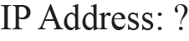
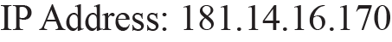
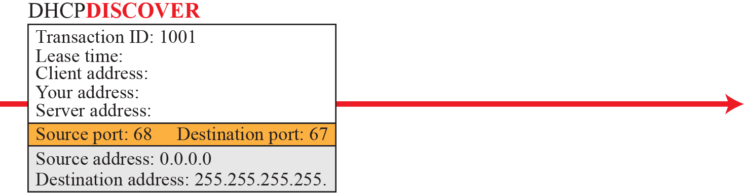
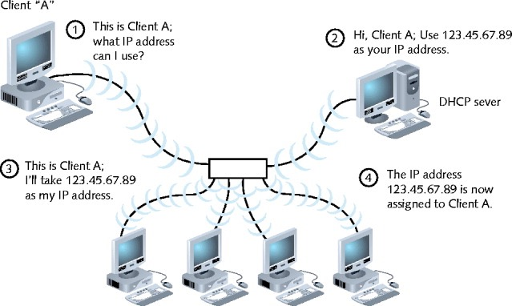
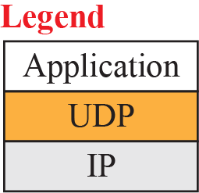
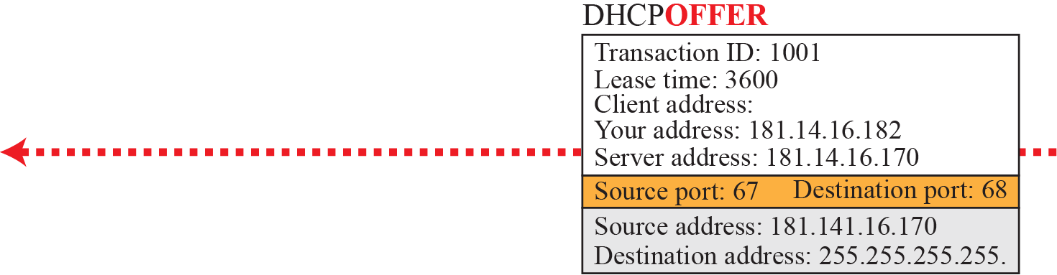
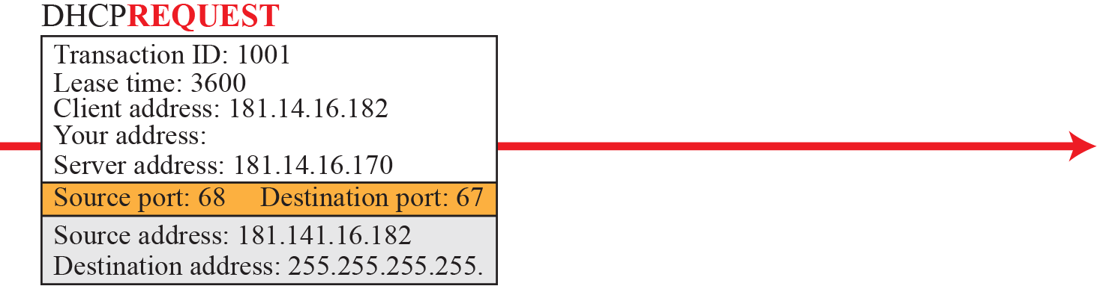
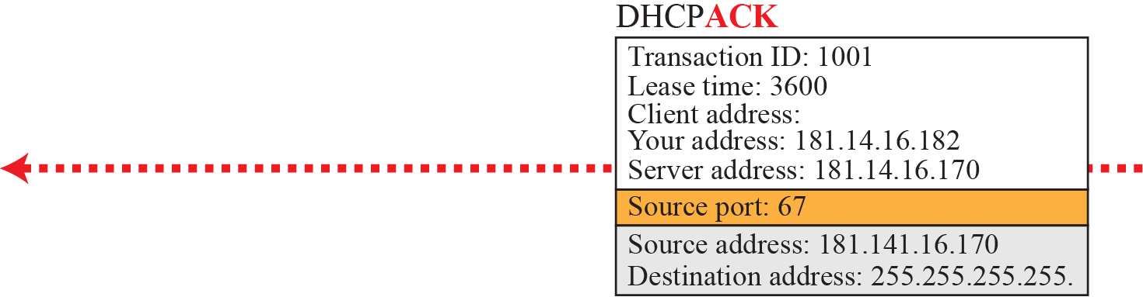
DHCP: Other Diagrams
The DHCP leasing process
Notes:
Although you can manually assign IP addresses the process can be tedious so DHCP servers are an essential component of the network.
DHCP servers are each in charge of a range of IP addresses
They lease (loan out) IP addresses for a specified period of time (so if you are idle and not using your PC the IP address is returned to the DHCP server so it may lend it out to someone else)

Slide 17
Private vs Public IP addresses
Public or Global address
Private address
Routable in the Internet
You have to pay to use
You can see yours by googling “what is my IP”
Not routable in the Internet
Free to use
You can see yours in the CMD prompt (ipconfig)
10.0.0.0/8 → 10.0.0.0 to 10.255.255.255
172.16.0.0/12 → 172.16.0.0 to 172.31.255.255
192.168.0.0/16 → 192.168.0.0 to 192.168.255.255
Notes:
I don’t expect you to memorize the reserved blocks for private IP addresses but you should know the 2 differences between private and public IP addresses

Slide 18
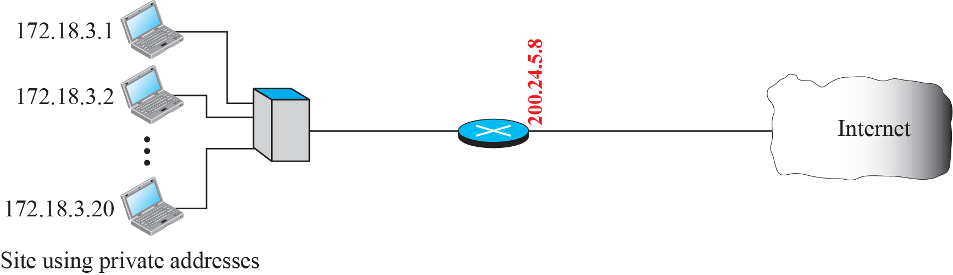
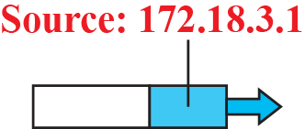
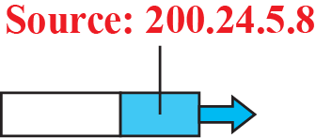
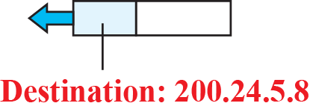
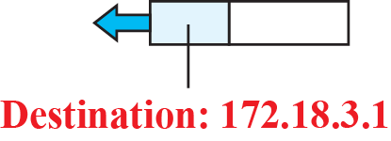
How do I connect to the internet with a private IP address?
What is a NAT?
Why would you want to use a NAT?
Notes:
- You can’t connect to the internet with a private IP, not by yourself anyways – you need to make use of a special router called a network address translator. This device maps the private IP to an available public IP and this allows you to browse the internet.
This lets your network communicate locally and also allows you to save money (not every workstation needs an IP address, they only borrow an IP address when they need it)
----
Why would you want to use a NAT router?
Improves security
Saves on IP addresses (see next 2 points)
Your printers and other devices that need an IP to communicate locally do not need a public IP
Multiple users in the network can actually share 1 public IP
This is actually what almost all ISPs use to save on IP addresses!

Slide 19
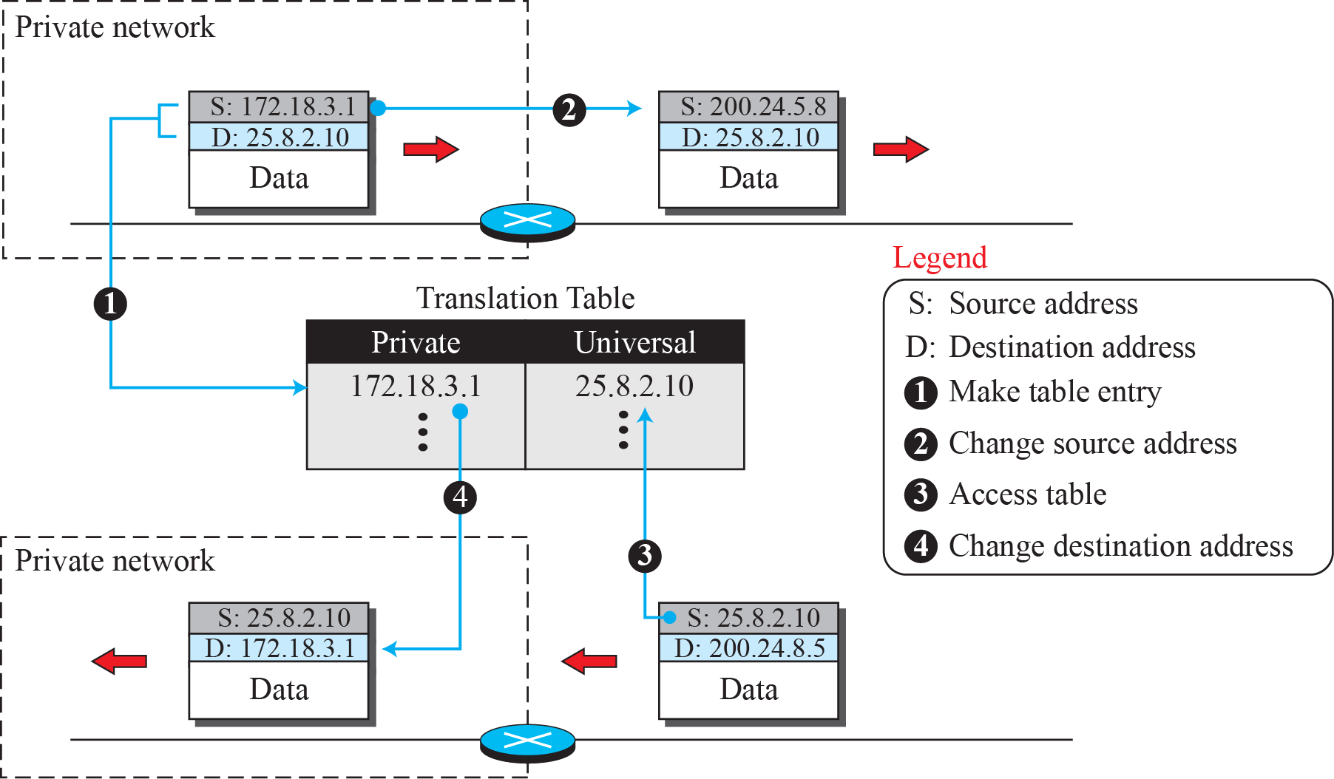
Network Address Translation
Notes:
NAT routers use a table to keep track of how private IP addresses are being mapped to public IP addresses.

Slide 20
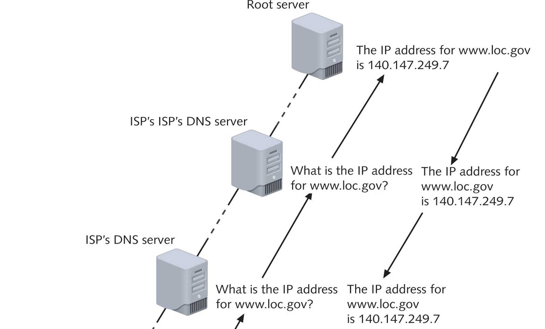
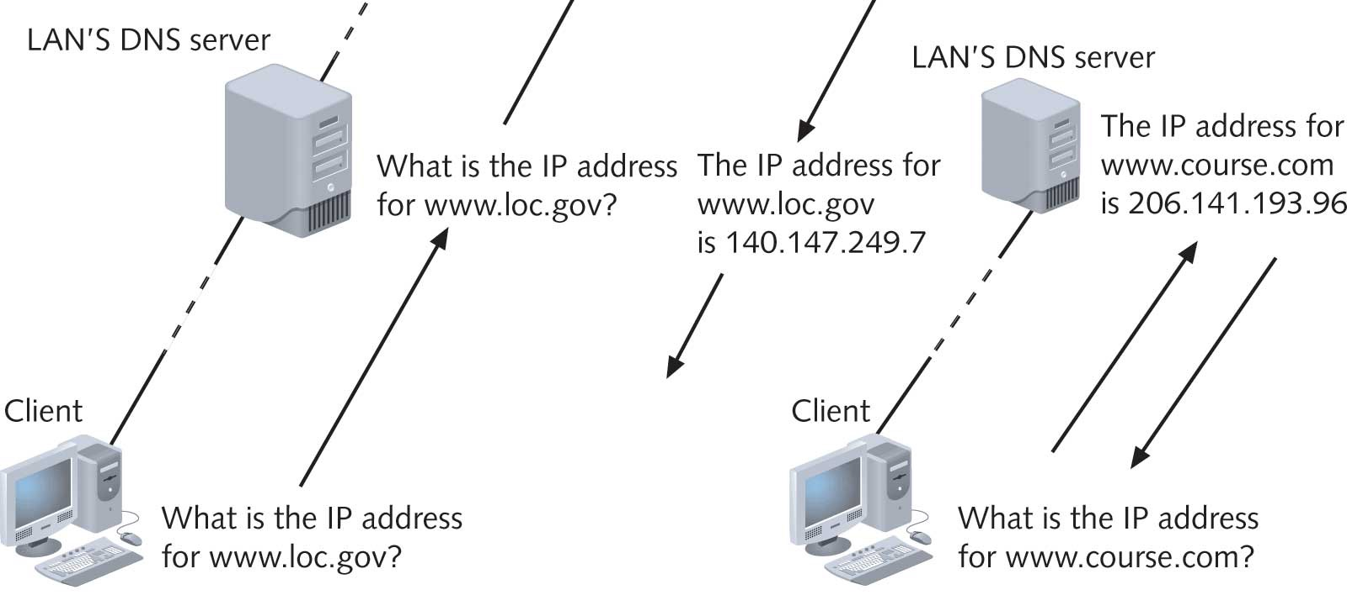
DNS Servers
As we learned in the first half of the course, the IP address is what PCs use in order to find the correct destination.
However, we as humans probably don’t want to memorize the IPs for websites
What is the role of the DNS server?
Explain (briefly) the hierarchy of the DNS server with the provided image
Notes:
Hierarchical method of associating domain names with IP addresses
Refers to Application layer service that accomplishes association and organized system of computers and databases making association possible
Relies on many computers around world
Thirteen root servers
Three components:
Resolvers
Name servers
Name space
DNS converts from hostnames/domain names to IP addresses. Domain names must be registered with ICANN.
So if you want to go to google.com then the DNS server will help your computer find the IP address
A DNS server is not, strictly speaking, necessary to communicate on the internet but it is a lot more convenient (imagine memorizing IP addresses!)
This image shows how the DNS server works. It maintains a list of the mappings of websites to their IP addresses.
If your PC does not know the mapping for an IP (say it doesn’t know the IP for www.loc.gov) it will first go to the LANs DNS server
If the LAN doesn’t know the mapping it will go to the ISP (internet service provider)
If the ISP doesn’t know the mapping it will go to the root server (these are the 13 servers .com, .ca, .gov, etc.) and these MUST contain the mapping for any domain name
The information will then be passed down and saved by each of the servers (that way if someone else makes a request they will have the information without needing to go to the root server)

Slide 21
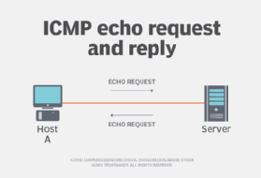
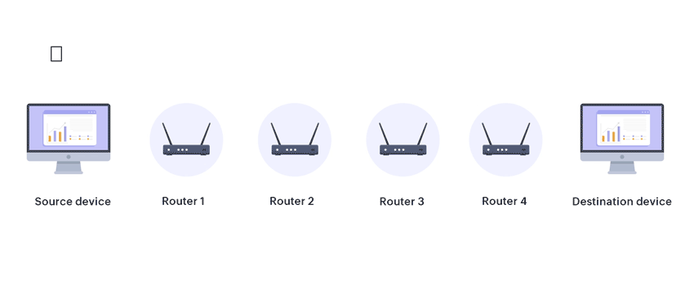
ICMP and ARP
ICMP: Tracert + Ping
You’ll get to see more about how ping works in this week’s in class activity where you’ll be building your very own ping packet
What two purposes does ping serve?
How does tracert work?
Notes:
Ping works by sending an ICMP echo request to a destination which then replies with an ICMP reply packet. This serves two purposes: first, it lets you know that the destination is reachable and second it tells you the latency (time) to reach the destination
Tracert makes use of the underlying protocol ICMP protocol and sends various packets of different time to lives (TTL). The first packet it sends has a TTL of 1 and will arrive at the router of the source network. The next packet has a TTL of 2 and will go

Slide 22
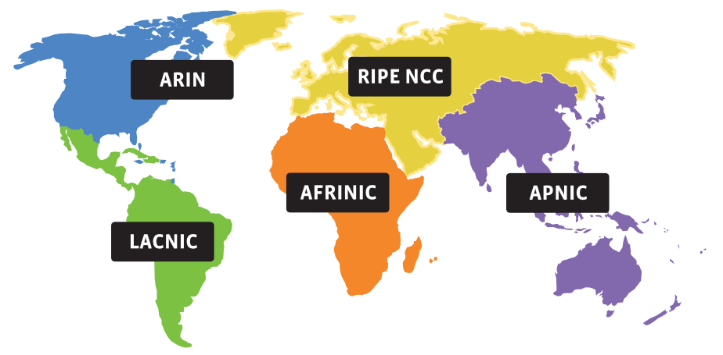
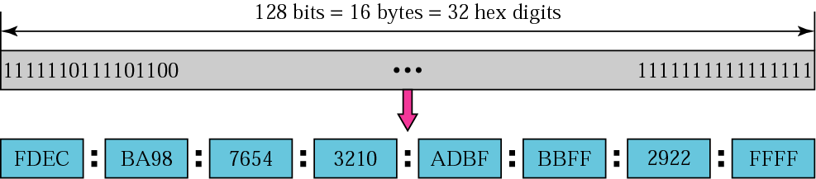
IPv6
IPv6 has 128 bits (as opposed to IPv4’s 32 bits)
The primary reason for the switch to IPv6 is for the additional addresses
Also boasts increased security and header efficiency and eliminates the need for subnetting (we have such a large space it is a simple matter to create networks of equal size)
Addresses are written in hexadecimal (due to the number of bits)
We also organize IPs into regions based on geography
Notes:
Each continent has several blocks assigned geographically
The blocks are *massive* and this allows AWS and other cloud providers to carved out other blocks from /24

Slide 23
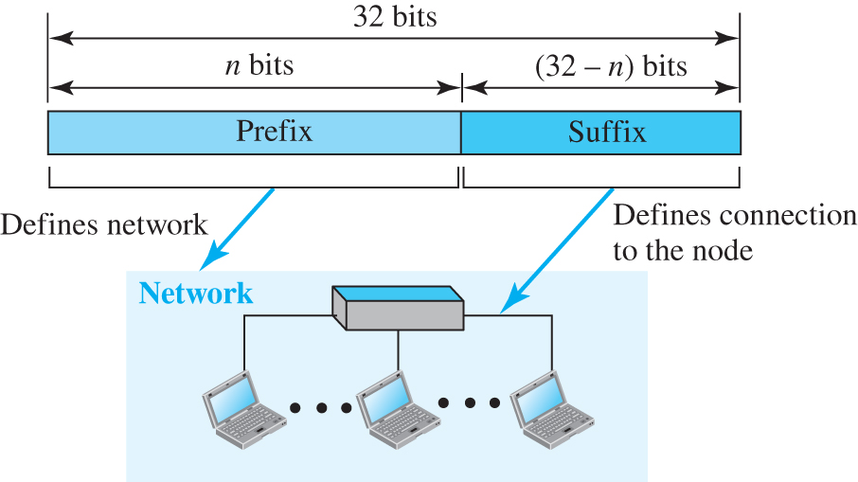
IPv4 Subnetting: A Primer: Cisco Routers
Subnetting is the process of borrowing “host” bits for “network information”.
Doing this creates “sub” networks (subnetting)
Some rules to keep in mind:
If all bits are 0 > the router reads this as the “subnet ID”
Think of this like the name of the subnet
We cannot assign the subnet ID to a single PC as it is the name of the whole area
If all bits are 1 > the router reads this as a “broadcast ID” and uses it to send messages to all PCs in the subnet
We cannot assign the broadcast ID to a single PC as it is used to send broadcasts to the subnet
23
Notes:
Cisco routers are unique as when we borrow bits and generate subnets we have access to 2 additional subnets (#subnets = 2^n). Non-cisco routers actually lose out on 2 subnets due to the rules at the right (the first subnet will be all 0s and the last subnet will be all 1s which the router reads as being reserved).
Cisco developed a protocol called zerconf which they patented and thus only cisco routers have access to those 2 extra subnets

Slide 24
1. #bits borrowed and class of network is provided
4. CIDR Notation
CIDR indicates the total bits used for network info so it’s a simple matter to go directly to the schematic
“Schematic”
Add up the indicated bits
3. #subnets needed is provided
Subnet Mask
256 - rightmost non-zero number of the subnet mask
*Block Size*
2. #hosts needed per subnet is provided
Class A: 0 -126 |  |  |  |  | #subnets = 2^{n} (n = number of bits borrowed for subnetting)
Class B: 128-191 |  |  |  |  | #hosts = 2^{m} - 2 (m = number of bits not used for network info)
Class C: 192-223
128 |  | 64 | 32 | 16 | 8 | 4 | 2 | 1
24
Notes:
I will provide the chart at the bottom on tests. You may find the map above helpful for solving subnetting questions

Slide 25
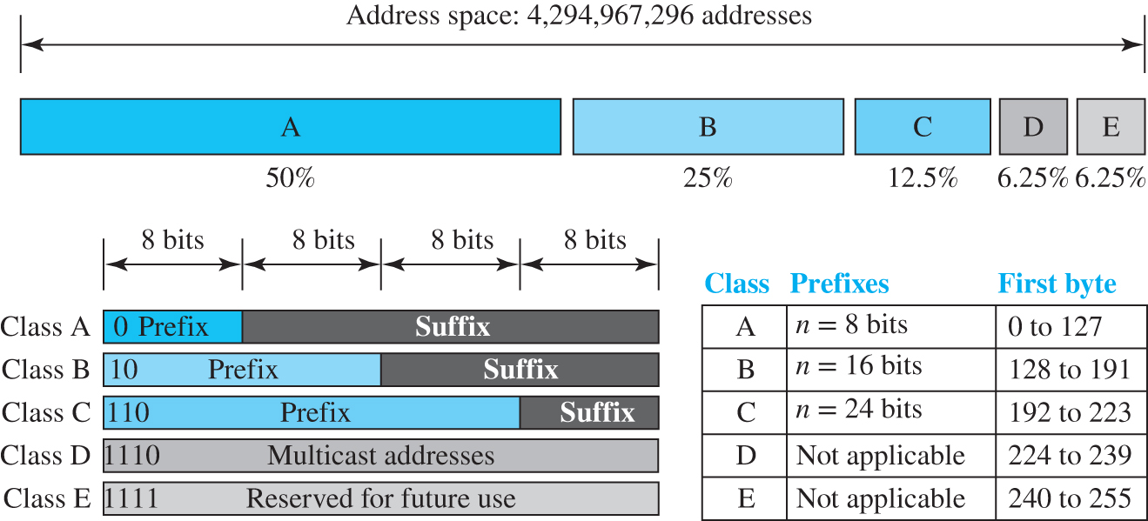


IPv4 – Address Space
Why isn’t 127 allowed?
126
Ugh
Why did the IP of 203.45.210.117 wear a tie?
Why did the IP 203.45.210.117 wear a tie?
The only way to tell the class of an IP is to look at the first octet
Because he was class C!
25
Notes:
127.0.0.1 is reserved for the loopback address
IP addresses are hierarchal (think of the area code of phone numbers).
This way routers do not need to know the IP address of every single network (instead they only need to know the right “general” area to send the information)
In addition internet designers mandated that the first octet contain information identifying the class of network.
Routers need only look at the first octet before sending packets to their appropriate destination

Slide 26
IPv4 – Class C – 2 bits borrowed
Let’s work with class C… it’s the easiest of the subnetting questions to start with
Let’s pretend our network is 200.200.200.X (this means we can use from 200.200.200.0 to 200.200.200.255)
We are going to borrow 2 bits for subnetting (we will explain this more later)
128 64 32 16 8 4 2 1
128 64 32 16 8 4 2 1
128 64 32 16 8 4 2 1
128 64 32 16 8 4 2 1
128 64 32 16 8 4 2 1
What are all the combinations for these two binary numbers?
128 | 64 | 32 | 16 | 8 | 4 | 2 | 1
0 | 0
0 | 1
1 | 0
1 | 1
128 | 64 | 32 | 16 | 8 | 4 | 2 | 1
0 | 0
0 | 1
1 | 0
1 | 1
128 | 64 | 32 | 16 | 8 | 4 | 2 | 1
0 | 0 | 1 | 1 | 1 | 1 | 1 | 1
0 | 1 | 1 | 1 | 1 | 1 | 1 | 1
1 | 0 | 1 | 1 | 1 | 1 | 1 | 1
1 | 1 | 1 | 1 | 1 | 1 | 1 | 1
128 | 64 | 32 | 16 | 8 | 4 | 2 | 1
0 | 0 | 0 | 0 | 0 | 0 | 0 | 0
0 | 1 | 0 | 0 | 0 | 0 | 0 | 0
1 | 0 | 0 | 0 | 0 | 0 | 0 | 0
1 | 1 | 0 | 0 | 0 | 0 | 0 | 0
= 0
= 63
= 64
= 127
= 128
= 191
= 192
= 255
What about the host bits? What’s the least value I can have for them? What’s the largest value I can have for them?
26
Notes:
Result: We have broken the last octet up into 4 “sub” networks
The last octet used to range from 0 to 255
NOW: depending on the value in the IP address in the last octet it will be in 1 of the 4 subnets below

Slide 27
IPv4 – Class C – 3 bits borrowed
Instead of borrowing 2 bits borrow 3 bits this time (you will create 8 subnets!)
128 64 32 16 8 4 2 1
128 64 32 16 8 4 2 1
128 64 32 16 8 4 2 1
128 64 32 16 8 4 2 1
128 64 32 16 8 4 2 1
What are all the combinations for these three binary numbers?
128 | 64 | 32 | 16 | 8 | 4 | 2 | 1
0 | 0 | 0
0 | 0 | 1
0 | 1 | 0
0 | 1 | 1
1 | 0 | 0
1 | 0 | 1
1 | 1 | 0
1 | 1 | 1
128 | 64 | 32 | 16 | 8 | 4 | 2 | 1
0 | 0 | 0 | 1 | 1 | 1 | 1 | 1
0 | 0 | 1 | 1 | 1 | 1 | 1 | 1
0 | 1 | 0 | 1 | 1 | 1 | 1 | 1
0 | 1 | 1 | 1 | 1 | 1 | 1 | 1
1 | 0 | 0 | 1 | 1 | 1 | 1 | 1
1 | 0 | 1 | 1 | 1 | 1 | 1 | 1
1 | 1 | 0 | 1 | 1 | 1 | 1 | 1
1 | 1 | 1 | 1 | 1 | 1 | 1 | 1
128 | 64 | 32 | 16 | 8 | 4 | 2 | 1
0 | 0 | 0 | 0 | 0 | 0 | 0 | 0
0 | 0 | 1 | 0 | 0 | 0 | 0 | 0
0 | 1 | 0 | 0 | 0 | 0 | 0 | 0
0 | 1 | 1 | 0 | 0 | 0 | 0 | 0
1 | 0 | 0 | 0 | 0 | 0 | 0 | 0
1 | 0 | 1 | 0 | 0 | 0 | 0 | 0
1 | 1 | 0 | 0 | 0 | 0 | 0 | 0
1 | 1 | 1 | 0 | 0 | 0 | 0 | 0
128 | 64 | 32 | 16 | 8 | 4 | 2 | 1
0 | 0 | 0
0 | 0 | 1
0 | 1 | 0
0 | 1 | 1
1 | 0 | 0
1 | 0 | 1
1 | 1 | 0
1 | 1 | 1
= 0
= 31
= 32
= 63
= 64
= 95
= 96
= 127
= 128
= 159
= 160
= 191
= 192
= 223
= 224
= 255
27
Notes:
Result: We have broken the last octet up into 8 “sub” networks
This binary method always works…it’s just not the most efficient method

Slide 28
Subnet Mask
The subnet mask indicates which bits are used for network information
If a bit is used for network information then it is a 1 (in red below) in the subnet mask, otherwise it’s a 0 (in green below)
The subnet masks for class A, B and C networks are shown below assuming that there are NO subnets being created (i.e. no bits borrowed for subnetting)
Class A - first octet 0 to 126 - 255.0.0.0
128 64 32 16 8 4 2 1
128 64 32 16 8 4 2 1
128 64 32 16 8 4 2 1
128 64 32 16 8 4 2 1
Class B - first octet 128 to 191 - 255.255.0.0
128 64 32 16 8 4 2 1
128 64 32 16 8 4 2 1
128 64 32 16 8 4 2 1
128 64 32 16 8 4 2 1
Class C - first octet 192 to 223 - 255.255.255.0
128 64 32 16 8 4 2 1
128 64 32 16 8 4 2 1
128 64 32 16 8 4 2 1
128 64 32 16 8 4 2 1
The subnet mask NEVER tells you the class of a network!
28
Notes:
Think of this like an area code:
Class A networks the first octet is fixed and the other 3 octets are free
E.g. 10.X.X.X
We would be stuck with the 10 here
--------
Class B networks the first 2 octets are fixed and the last 2 octets are free
E.g. 151.37.X.X
We would be stuck with 151 and 37 here
--------
Class C networks the first 3 octets are fixed and only the last octet is free
E.g. 200.41.60.X
We would be stuck with 200, 41 and 60 in this example

Slide 29
IPv4 – 200.200.200.X - Class C – 2 bits borrowed
128 64 32 16 8 4 2 1
128 64 32 16 8 4 2 1
128 64 32 16 8 4 2 1
128 64 32 16 8 4 2 1
1. Schematic | 2. Subnet Mask | 3. Block Size | 4. #subnets | 5. # hosts
This is a made up step that I use to help find the subnet mask | Add up the bits of the schematic | 256 – rightmost, non-zero number in the subnet mask | 2^n n = #bits borrowed | 2^m – 2 m = number of bits NOT used for network info
I use the schematic
There are 2 bits borrowed
2^2 = 4
<8><8><8><2>
255.255.255.192
*256* - 192 = 64
<8><8><8><2>
Class C
2 bits borrowed
There are 6 bits free = 2^6 – 2
-1
200.200.200.
To fill out the chart, write the given octets, then start at 0 in SID and count by the block size
Subnet ID | Broadcast ID | Valid Host Range
+1
0
200.200.200.
1-62
200.200.200.
63
64
127
65-126
128
191
129-190
192
255
193-254
256
29
Notes:
This is the same problem as before but handled much easier.
The subnet mask indicates which bits are used for hosts and which bits are used for network information
Subnetting: Class C Subnet Mask (210.30.40.X)
First you need the subnet mask
I write the schematic first. It’s a class C network so that’s where I got <8><8><8> from (definition of class C)
The 2 is because this question involved borrowing 2 bits
<8><8><8><2>
Adding up these bits gives us the subnet mask
Adding up all 8 numbers is 255
Adding up the first 2 numbers is 128+64 which is 192
You can find the block size next
It’s always 256 (256 addresses from 0 to 255)
Then you take the last number (that’s not zero) in the subnet mask and subtract it from 256
256-192 in this example
Block size is thus 64.
Pro tip: the block size is always a power of 2: 128, 64, 32, 16, 8, 4, 2 or 1
You can then use the block size to complete the chart.
- Write the given octets first 210.30.40. You’re stuck with those (they’re the “area code”)
For the last octet start at 0 and then just count by the block size and fill out the subnet ID column
0, 64, 128, 192 – the next one would be 256 – this would be too large
I use these to find the BID. Since the second SID is 64 the first BID, the first subnet, must go up to 63
Similarly, the second BID must be 127 if the 3rd row starts at 128
Valid host range is everything in between the SID and BID
----
#subnets 2^2. You’ll be able to leave your answers as powers of 2 but in this case it’s just 4 subnets in total
N = number of bits borrowed and the question tells us its 2 bits borrowed
#hosts = 2^m – 2 = 2^6 -2
- It’s easy to see this visually here. It’s just the green bits that are left in the top representation

Slide 30
IPv4 – 200.200.200.X - Class C – 3 bits borrowed
128 64 32 16 8 4 2 1
128 64 32 16 8 4 2 1
128 64 32 16 8 4 2 1
128 64 32 16 8 4 2 1
1. Schematic | 2. Subnet Mask | 3. Block Size | 4. #subnets | 5. # hosts
This is a made up step that I use to help find the subnet mask | Add up the bits of the schematic | 256 – rightmost, non-zero number in the subnet mask | 2^n n = #bits borrowed | 2^m – 2 m = number of bits NOT used for network info
I use the schematic
There are 3 bits borrowed
2^3 = 8
<8><8><8><3>
255.255.255.224
*256* - 224 = 32
<8><8><8><3>
Class C
3 bits borrowed
There are 5 bits free = 2^5 – 2
-1
200.200.200.
To fill out the chart, write the given octets, then start at 0 in SID and count by the block size
Subnet ID | Broadcast ID | Valid Host Range
+1
0
200.200.200.
1-30
200.200.200.
31
32
63
33-62
64
95
65-94
96
127
97-126
128
30
Notes:
This is the same problem as before but handled much easier.
The subnet mask indicates which bits are used for hosts and which bits are used for network information
Subnetting: Class C Subnet Mask (210.30.40.X)
First you need the subnet mask
I write the schematic first. It’s a class C network so that’s where I got <8><8><8> from (definition of class C)
The 3 is because this question involved borrowing 3 bits
<8><8><8><3>
Adding up these bits gives us the subnet mask
Adding up all 8 numbers is 255
Adding up the first 3 numbers is 128+64+32 which is 224
You can find the block size next
It’s always 256 (256 addresses from 0 to 255)
Then you take the last number (that’s not zero) in the subnet mask and subtract it from 256
256-224 in this example
Block size is thus 32.
Pro tip: the block size is always a power of 2: 128, 64, 32, 16, 8, 4, 2 or 1
You can then use the block size to complete the chart.
- Write the given octets first 200.200.200. You’re stuck with those (they’re the “area code”)
For the last octet start at 0 and then just count by the block size and fill out the subnet ID column
0, 32, 64, 96 – the next one would be 128 – I’ll usually ask you to stop at 4 rows
I use these to find the BID. Since the second SID is 32 then the first BID of the first subnet, must go up to 31
Similarly, the second BID must be 63 if the 3rd row starts at 64
Valid host range is everything in between the SID and BID
----
#subnets 2^3. You’ll be able to leave your answers as powers of 2 but in this case it’s just 8 subnets in total
N = number of bits borrowed and the question tells us its 3 bits borrowed
#hosts = 2^m – 2 = 2^5 -2
- It’s easy to see this visually here. It’s just the green bits that are left in the top representation

Slide 31
IPv4 – 200.200.200.X - Class C – 4 bits borrowed
128 64 32 16 8 4 2 1
128 64 32 16 8 4 2 1
128 64 32 16 8 4 2 1
128 64 32 16 8 4 2 1
1. Schematic | 2. Subnet Mask | 3. Block Size | 4. #subnets | 5. # hosts
This is a made up step that I use to help find the subnet mask | Add up the bits of the schematic | 256 – rightmost, non-zero number in the subnet mask | 2^n n = #bits borrowed | 2^m – 2 m = number of bits NOT used for network info
I use the schematic
There are 4 bits borrowed
2^4 = 16
<8><8><8><4>
255.255.255.240
*256* - 240 = 16
<8><8><8><4>
Class C
4 bits borrowed
There are 4 bits free = 2^4 – 2
-1
200.200.200.
To fill out the chart, write the given octets, then start at 0 in SID and count by the block size
Subnet ID | Broadcast ID | Valid Host Range
+1
0
200.200.200.
1-14
200.200.200.
15
16
31
17-30
32
47
33-46
48
63
49-62
64
31
Notes:
This is the same problem as before but handled much easier.
The subnet mask indicates which bits are used for hosts and which bits are used for network information
Subnetting: Class C Subnet Mask (210.30.40.X)
First you need the subnet mask
I write the schematic first. It’s a class C network so that’s where I got <8><8><8> from (definition of class C)
The 4 is because this question involved borrowing 4 bits
<8><8><8><4>
Adding up these bits gives us the subnet mask
Adding up all 8 numbers is 255
Adding up the first 4 numbers is 128+64+32+16 which is 240
You can find the block size next
It’s always 256 (256 addresses from 0 to 255)
Then you take the last number (that’s not zero) in the subnet mask and subtract it from 256
256-240 in this example
Block size is thus 16.
Pro tip: the block size is always a power of 2: 128, 64, 32, 16, 8, 4, 2 or 1
You can then use the block size to complete the chart.
- Write the given octets first 200.200.200. You’re stuck with those (they’re the “area code”)
For the last octet start at 0 and then just count by the block size and fill out the subnet ID column
0, 16, 32, 48 – the next one would be 64 – I’ll usually ask you to stop at 4 rows
I use these to find the BID. Since the second SID is 16 then the first BID of the first subnet, must go up to 15
Similarly, the second BID must be 31 if the 3rd row starts at 32
Valid host range is everything in between the SID and BID
----
#subnets 2^4. You’ll be able to leave your answers as powers of 2 but in this case it’s just 16 subnets in total
N = number of bits borrowed and the question tells us its 3 bits borrowed
#hosts = 2^m – 2 = 2^4 -2
- It’s easy to see this visually here. It’s just the green bits that are left in the top representation

Slide 32
IPv4 – 200.200.200.X - Class C – 5 bits borrowed
128 64 32 16 8 4 2 1
128 64 32 16 8 4 2 1
128 64 32 16 8 4 2 1
128 64 32 16 8 4 2 1
1. Schematic | 2. Subnet Mask | 3. Block Size | 4. #subnets | 5. # hosts
This is a made up step that I use to help find the subnet mask | Add up the bits of the schematic | 256 – rightmost, non-zero number in the subnet mask | 2^n n = #bits borrowed | 2^m – 2 m = number of bits NOT used for network info
I use the schematic
There are 5 bits borrowed
2^5 = 32
<8><8><8><5>
255.255.255.248
*256* - 248 = 8
<8><8><8><5>
Class C
5 bits borrowed
There are 3 bits free = 2^3 – 2
-1
200.200.200.
To fill out the chart, write the given octets, then start at 0 in SID and count by the block size
Subnet ID | Broadcast ID | Valid Host Range
+1
0
200.200.200.
1-6
200.200.200.
7
8
15
9-14
16
23
17-22
24
31
25-30
32
32
Notes:
This is the same problem as before but handled much easier.
The subnet mask indicates which bits are used for hosts and which bits are used for network information
Subnetting: Class C Subnet Mask (210.30.40.X)
First you need the subnet mask
I write the schematic first. It’s a class C network so that’s where I got <8><8><8> from (definition of class C)
The 5 is because this question involved borrowing 5 bits
<8><8><8><5>
Adding up these bits gives us the subnet mask
Adding up all 8 numbers is 255
Adding up the first 5 numbers is 128+64+32+16+8 which is 248
You can find the block size next
It’s always 256 (256 addresses from 0 to 255)
Then you take the last number (that’s not zero) in the subnet mask and subtract it from 256
256-248 in this example
Block size is thus 8.
Pro tip: the block size is always a power of 2: 128, 64, 32, 16, 8, 4, 2 or 1
You can then use the block size to complete the chart.
- Write the given octets first 200.200.200. You’re stuck with those (they’re the “area code”)
For the last octet start at 0 and then just count by the block size and fill out the subnet ID column
0, 8, 16, 24– the next one would be 32 – I’ll usually ask you to stop at 4 rows
I use these to find the BID. Since the second SID is 8 then the first BID of the first subnet, must go up to 7
Similarly, the second BID must be 15 if the 3rd row starts at 16
Valid host range is everything in between the SID and BID
----
#subnets 2^5. You’ll be able to leave your answers as powers of 2 but in this case it’s just 16 subnets in total
N = number of bits borrowed and the question tells us its 3 bits borrowed
#hosts = 2^m – 2 = 2^3 -2
- It’s easy to see this visually here. It’s just the green bits that are left in the top representation

Slide 33
IPv4 – 200.200.200.X - Class C – 6 bits borrowed
128 64 32 16 8 4 2 1
128 64 32 16 8 4 2 1
128 64 32 16 8 4 2 1
128 64 32 16 8 4 2 1
1. Schematic | 2. Subnet Mask | 3. Block Size | 4. #subnets | 5. # hosts
This is a made up step that I use to help find the subnet mask | Add up the bits of the schematic | 256 – rightmost, non-zero number in the subnet mask | 2^n n = #bits borrowed | 2^m – 2 m = number of bits NOT used for network info
I use the schematic
There are 6 bits borrowed
2^6 = 64
<8><8><8><6>
255.255.255.252
*256* - 252 = 4
<8><8><8><6>
Class C
6 bits borrowed
There are 2 bits free = 2^2 – 2
-1
200.200.200.
To fill out the chart, write the given octets, then start at 0 in SID and count by the block size
Subnet ID | Broadcast ID | Valid Host Range
+1
0
200.200.200.
1-2
200.200.200.
3
4
7
5-6
8
11
9-10
12
15
13-14
16
33
Notes:
This is the same problem as before but handled much easier.
The subnet mask indicates which bits are used for hosts and which bits are used for network information
Subnetting: Class C Subnet Mask (210.30.40.X)
First you need the subnet mask
I write the schematic first. It’s a class C network so that’s where I got <8><8><8> from (definition of class C)
The 6 is because this question involved borrowing 6 bits
<8><8><8><6>
Adding up these bits gives us the subnet mask
Adding up all 8 numbers is 255
Adding up the first 6 numbers is 128+64+32+16+8+4 which is 252
You can find the block size next
It’s always 256 (256 addresses from 0 to 255)
Then you take the last number (that’s not zero) in the subnet mask and subtract it from 256
256-252 in this example
Block size is thus 4.
Pro tip: the block size is always a power of 2: 128, 64, 32, 16, 8, 4, 2 or 1
You can then use the block size to complete the chart.
- Write the given octets first 200.200.200. You’re stuck with those (they’re the “area code”)
For the last octet start at 0 and then just count by the block size and fill out the subnet ID column
0, 4, 8, 12– the next one would be 16 – I’ll usually ask you to stop at 4 rows
I use these to find the BID. Since the second SID is 4 then the first BID of the first subnet, must go up to 3
Similarly, the second BID must be 7 if the 3rd row starts at 8
Valid host range is everything in between the SID and BID
----
#subnets 2^5. You’ll be able to leave your answers as powers of 2 but in this case it’s just 16 subnets in total
N = number of bits borrowed and the question tells us its 3 bits borrowed
#hosts = 2^m – 2 = 2^3 -2
- It’s easy to see this visually here. It’s just the green bits that are left in the top representation

Slide 34
Subnetting: Other Types of Questions
The question might specify the number of subnets they want to create
The question might specify the number of hosts they want to create
The CIDR notation might be given
#subnets | 0-4 | 5-8 | 9-16 | 17-32 | 33-64
Bits borrowed | 2 | 3 | 4 | 5 | 6
N.B. that 2, 3, 4, etc… bits borrowed also supports 0-2 subnets
Hosts | 0-2 | 3-6 | 7-14 | 15-30 | 31-62
Block Size | 4 | 8 | 16 | 32 | 64
N.B. that a block size of 8, 16, 32, etc… still supports 0-2 hosts
CIDR | /26 | /27 | /28 | /29 | /30
Schematic
<8><8><8><2>
<8><8><8><3>
<8><8><8><4>
<8><8><8><5>
<8><8><8><6>
34

Slide 35
Subnetting: Practice
If you want to generate your own practice problem either
Select a number of subnets to create from 0-64 (then you can find the bits borrowed and solve)
Select a number of hosts to create from 0-62 then you can find the block size
Select a CIDR: /26, /27, /28, /29, /30
#subnets | 0-4 | 5-8 | 9-16 | 17-32 | 33-64
Bits borrowed | 2 | 3 | 4 | 5 | 6
Hosts | 0-2 | 3-6 | 7-14 | 15-30 | 31-62
Block Size | 4 | 8 | 16 | 32 | 64
CIDR | /26 | /27 | /28 | /29 | /30
Schematic
<8><8><8><2>
<8><8><8><3>
<8><8><8><4>
<8><8><8><5>
<8><8><8><6>
35

Slide 36
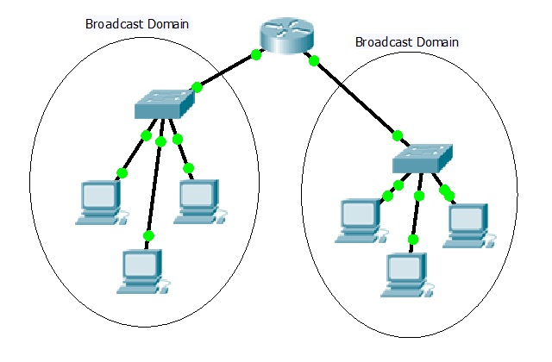
IP Labelling - /28
Each broadcast domain must be its own subnet (its own row in the chart)
The first valid host in each range is reserved for the routers interface
1
17
2
3
18
24
10
20
Subnet ID | Broadcast ID | Valid Host Range
200.30.5. | 200.30.5.[ ]
0
15
1-14
Schematic: <8><8><8><4>
Subnet Mask 255.255.255.240
16
31
17-30
32

Slide 37
IP Labelling - /27
SID | BID | VHR
0 | 31 | 1-30
32 | 63 | 33-62
64 | 95 | 65-94
Router
65
1
33
Sw
Sw
Sw
PC
PC
PC
PC
PC
PC
3
7
34
35
70
80

Slide 38
Week 09 Transport Layer: TCP/UDP

Slide 39
Attendance Question
Every week I will have a silly question (usually) as a way to get to know everyone.
These are not for marks but instead a way for me to get to know everyone!
If you have a different name that you prefer I use, or if I pronounce your name incorrectly – let me know!
Week 09: What is your ideal pet?

Slide 40
For 210.30.120.X /27 - What Subnet ID can we find each of the following IP addresses?
IP: | 177 | 46 | 189 | 1 | 234 | 240 | 40 | 4 | 63
SID
160
32
160
0
224
224
32
0
32
SID | BID | VHR
210.30.120.0 | 210.30.120.31 | 1-30
32 | 63 | 33-62
64 | 95 | 65-94
96 | 127 | 97-126
128 | 159 | 129-158
160 | 191 | 161-190
192 | 223 | 193-222
224 | 255 | 225-254
40
Notes:
ANDing is the process where we are trying to figure out which row a certain IP address is on. In this slide we are doing it many times
9 questions in that chart at the top of the page
However, in order to do the question we wrote out the entire subnet chart and what we want to do is avoid doing that

Slide 41
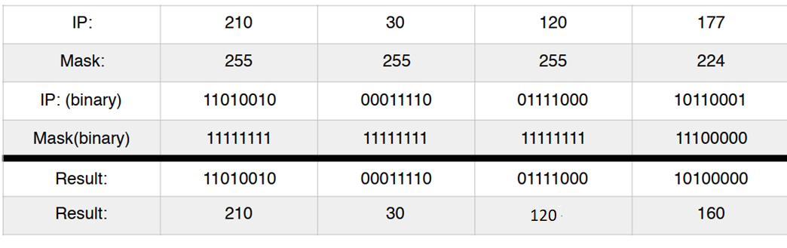
ANDing
To avoid binary we can make use of the following simplifications:
0 AND X > 0
255 AND X > X
*** there will always be 3 easy octets in every ANDing question ***
Else (if the mask is not 255 or 0)
IP / block size
Cut the fraction off the result
Multiply the number by the block size
41
Notes:
This demonstrates how a computer will do the same task as in the previous slide. It performs the logical operation of ANDing (which is essentially like multiplying the two numbers)
As a human we are going to use a trick to avoid binary
If you prefer you CAN use binary to solve these questions but the method we will learn will be much quicker. Even if you
You can also use the charts but they take a little bit of time
The 3 rules we are going to use that will make it a bit easier
255 AND X yields X. This is because 255 is all 1’s. (1 times X equals X)
0 AND X yields 0.
Else: we will use a division trick that will help us determine where the IP fits
In this example 177/32 (block size is 32)
Result is 5.____ (it’s some decimal but we are only interested in the whole number part)
Multiply 5 by the block size (5*32) which will yield 160
It’s the same answer but this is a lot quicker than using binary!

Slide 42
ANDing: How a Router Forwards
R1 gets a message for 180.70.65.198, 255.255.255.192
Which interface will it send it out?
IP | 180 | 70 | 65 | 198
SM | 255 | 255 | 255 | 192
180
70
65
192
198/64
3.____
3*64 = 192
42
Notes:
ANDing is the process where we are trying to figure out which row a certain IP address is on. In this slide we are doing it many times
9 questions in that chart at the top of the page
However, in order to do the question we wrote out the entire subnet chart and what we want to do is avoid doing that

Slide 43
ANDing Questions
IP | 179 | 34 | 89 | 127
SM | 255 | 255 | 252 | 0
IP | 212 | 21 | 46 | 143
SM | 255 | 255 | 255 | 248
179
34
88
0
212
21
46
136
89/4
22.__
22*4
143/8
17.__
17*8
IP | 10 | 201 | 29 | 226
SM | 255 | 240 | 0 | 0
IP | 159 | 197 | 20 | 132
SM | 255 | 255 | 224 | 0
10
192
0
0
159
197
0
0
201/16
12.___
12*16
20/32
0.__
0*32
For more practice visit subnetting.org
43

Slide 44
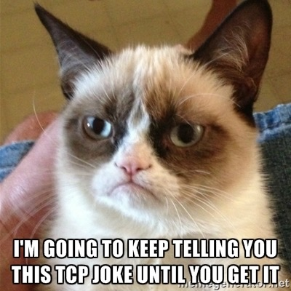
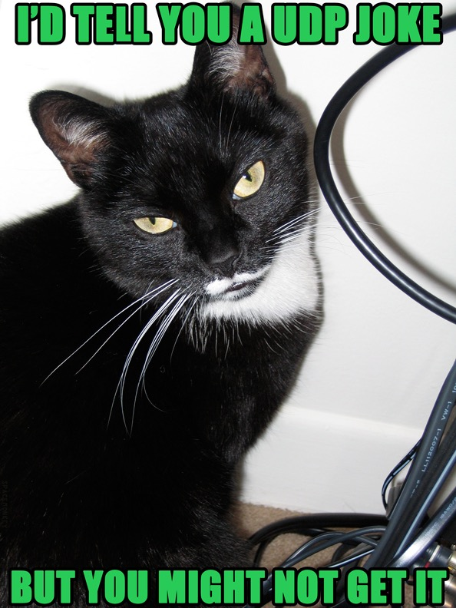
TCP vs UDP demo

Slide 45
TCP or UDP?
1. This protocols best feature is its reliability |  | 7. This protocol is used when visiting a webpage and displaying content
2. This protocols best feature is its speed |  | 8. This protocol is used when streaming a video from youtube
3. This protocol makes use of the 3 way handshake |  | 9. This protocol would be used to check your email
4. This protocol has a field for checksum |  | 10. This protocol would be used for downloading a large text file from the internet
5. This protocol has fields for sequence and acknowledgement numbers |  | 11. This protocol is used for making a DNS request
6. This protocol is used when listening to a song on spotify |  | 12. This protocol is used when playing an online video game
TCP
TCP
UDP
UDP
TCP
TCP
Both!
TCP
TCP
Both!
UDP
UDP

Slide 46
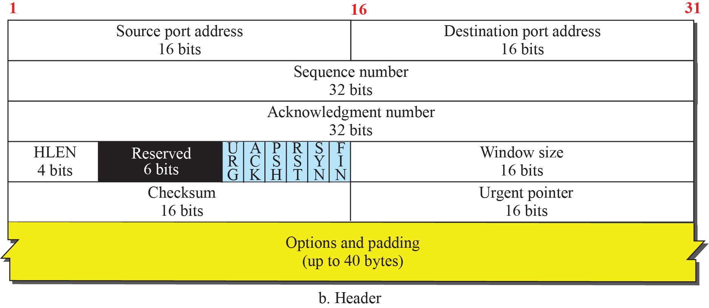
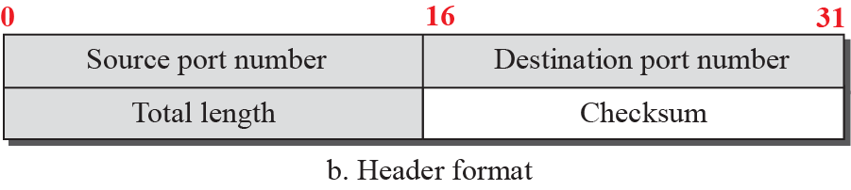
TCP
What do the TCP and UDP headers have in common? Why?
Port Number
-Both TCP and UDP want the right program still!
Checksum
TCP will resend if its wrong, UDP just discards
UDP
What is different in the headers? Why?
Sequence Number
TCP wants to make sure the message arrives in the correct order, UDP does not care
ACK Number
TCP wants to make sure that everything that is sent is received, UDP does not care
Control Flags
TCP uses these for the 3 way handshake to establish a reliable connection. UDP does not need them
SYN, ACK, FIN

Slide 47
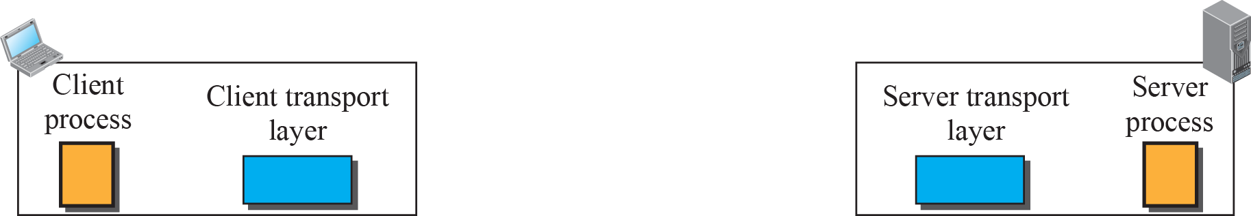
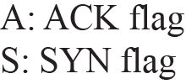

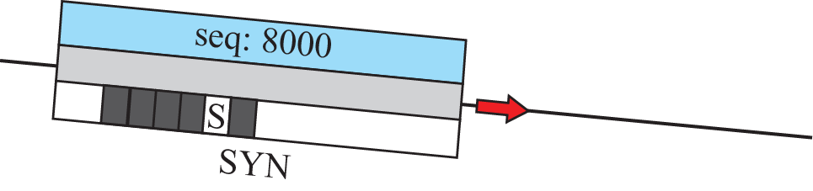

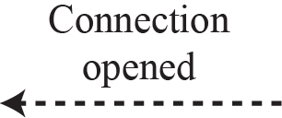
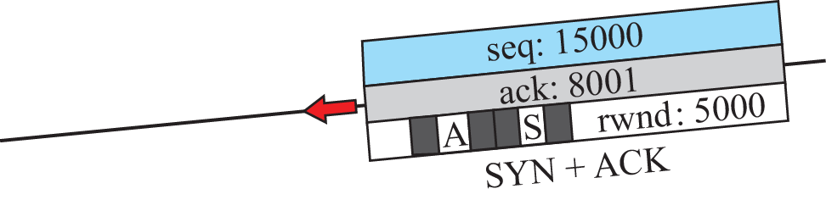
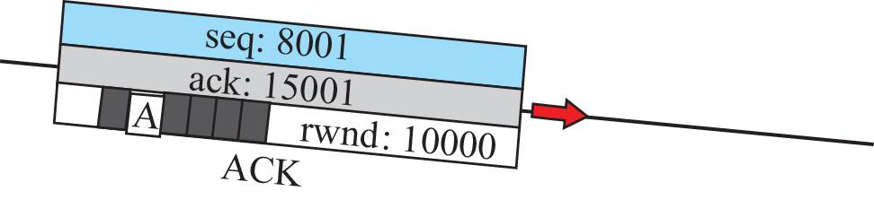
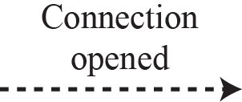
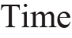
TCP: 3 Way Handshake (start a connection)
Flag | Sequence # | Ack #
SYN
20
(random)
Can I talk to you?
ACK
SYN
151
(random)
Yes.
Can I talk to you?
21
ACK
21
152
Yes.
1
0
2
3
47
Notes:
The sentences “can I talk to you”. “Yes. Can I talk to you”. “Yes” are just a memory aid for the flags. They will not appear on the test.
The number 20 and 151 were just randomly selected numbers. You can use any number you wish here but then you increment. So if the first blue number you chose was 1821 then the next message blue sent would have a sequence number of 1822.
The ACK numbers are a bit weird. The way I remember them is the following: The PC sends sequence number 20 and to acknowledge that message the server says “You sent me 20 and I am now ready to receive 21”. And the next message the PC sends will be the sequence number 21.

Slide 48
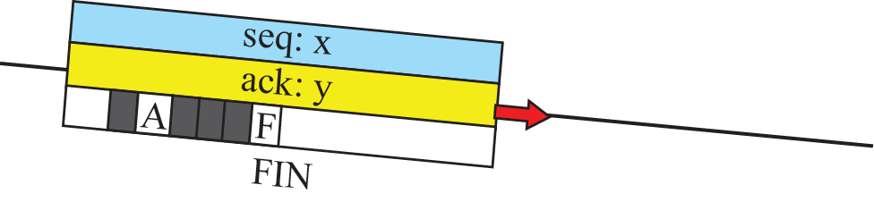

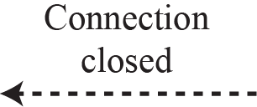
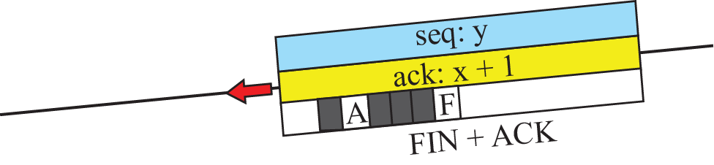

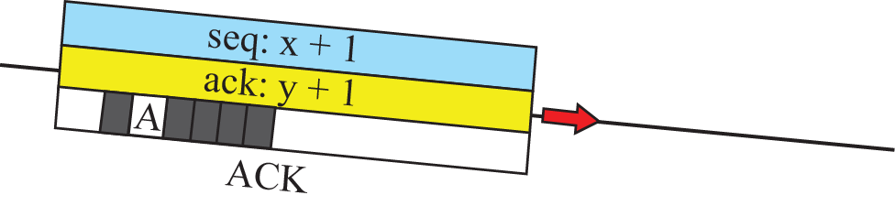
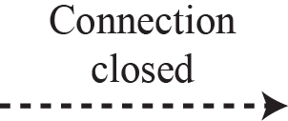
TCP: 3 Way Handshake (end a connection)
Y - 1
Flag | Sequence # | Ack #
FIN
X
Y
(Y - 1 + 1)
Can I stop talking to you?
ACK
FIN
Yes.
Can I stop talking to you?
Y
X+1
ACK
X + 1
Y+1
Yes.
48
Notes:
The sentences “can I stop talking to you”. “Yes. Can I stop talking to you”. “Yes” are just a memory aid for the flags. They will not appear on the test.
Initially the PC stated with message 20 but now we don’t know what number it’s at (it depends how much the PC sent). To represent this uncertainty we use the letter X, which makes the next message X+1
Same idea for the server. It was at 151 but we have no idea what it’s at now so we use the letter Y
The one major difference is the first step here does require an acknowledgment number

Slide 49
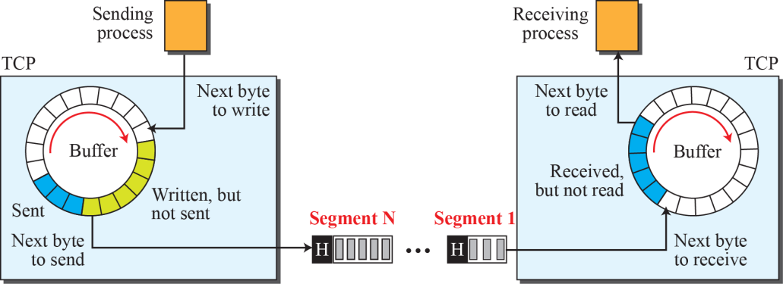
TCP: Buffer
TCP does not send 1 thing at a time (or everything at once). It will send up to the buffer limit and will wait for confirmation before sending more

Slide 50
Example Questions
What is TCP known for?
List an example of an application that would make use of TCP
What is UDP known for?
List an example of an application that would make use of UDP
Provided the diagram of the TCP/UDP header list the elements that are similar/different and explain why
Fill out the chart listing the steps (flags) of the 3 way handshake
Flag | Sequence # | Ack #
50

Slide 51
Week 10 Quiz 2

Slide 52
Quiz 2
Quiz 2 will be held in class this week
See slides 96 onwards for some matching/short answer examples
Quiz 2 (60 min time limit)
[14] MCQ
[5] ANDing
[5] Subnetting
[6] Short Answer
- 3 Questions
Quiz 2 covers all the material before this slide

Slide 53
Week 11 Application Layer
Notes:
Learning Goals
Distinguish between client server paradigm and peer to peer paradigm and provide examples of each
Discuss issues associated with client server and peer to peer paradigm
Discuss HTTP, WWW, and URL and how they are used to find web pages on the internet
Compare simple and composite web pages as well as static, dynamic and active web pages
Explain the difference between persistent and non persistent HTTP connections
Explain the general purpose of FTP as well as it’s major flaw

Slide 54
Attendance Question
Every week I will have a silly question (usually) as a way to get to know everyone.
These are not for marks but instead a way for me to get to know everyone!
If you have a different name that you prefer I use, or if I pronounce your name incorrectly – let me know!
Week 11: If you could be in any movie of your choice? What would it be?

Slide 55
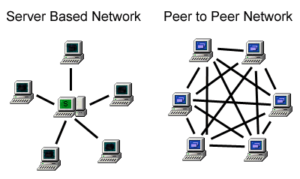
Client-Server vs Peer to Peer
In client-server the server hosts, provides and maintains the majority of the data
As a metaphor I like to compare the server to the teacher in the classroom and the students are “clients”
In a peer to peer (P2P) network all computers are considered equal (act as both client and server)
As a metaphor I like to compare the P2P model to working on a group project with other students
55
Notes:
https://www.networkstraining.com/peer-to-peer-vs-client-server-network/

Slide 56
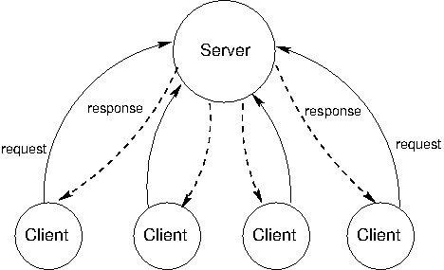
Client-Server
A common example of this type of architecture is the hosting of web pages
What considerations must be implemented in order to run the web server?
What are some advantages to this type of model?
What are some disadvantages?
56
Notes:
https://www.networkstraining.com/peer-to-peer-vs-client-server-network/
The server must be a powerful PC as it must run 24/7 and be able to handle the traffic it receives.
Typically the server will be cloned with different serves all being tied to the same DNS name using a load balancer
ADV:
Security: The server can control who is allowed to access the document
Reliability: The server is available 24/7
Adaptability: Client/Server is easily able to handle many tasks (hosting web pages or hosting files )
constant availability are all advantages to using the client/server model
DIS:
Cost: You have to pay to run the server
Slowdown: If many clients connect/more clients connect than expected it can lead to server slowdown
Crash: If a large number of clients connect you can crash the server

Slide 57
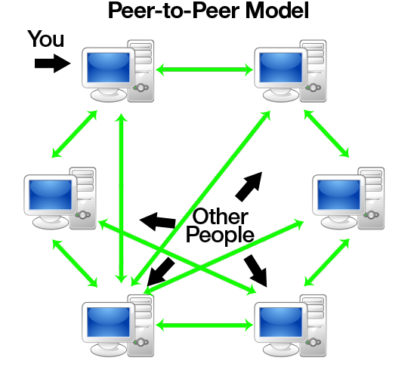
Peer to Peer (P2P)
A common example of this type of architecture is torrent files
Windows uses P2P to deliver windows 10 upgrades
Online games will make use of P2P technology to download games
Cryptocurrencies use blockchain P2P
What are some advantages of P2P?
What are some disadvantages?
57
Notes:
https://www.networkstraining.com/peer-to-peer-vs-client-server-network/
ADV
Cheap as no payment required for a central server
Speed of the internet connection usually does not impact the time it takes to download your files
If 1 PC crashes the system won’t be greatly impacted
Speed of connection actually increases with additional clients
DIS
Not useable for every type of application: a web page would not work well in the P2P model
Not secure – you can associate a password with P2P models but in order to access the files you must share the password
Has a history of sharing illegal movies/music/games/etc…
With few users distributing the file, it can actually be slower than client/server

Slide 58

World Wide Web: Web Pages
There are many components of being able to access web pages, we will discuss a few of them here
Web browsers
URL
HTTP
58

Slide 59


WWW: Web Browser
A web browser is an application that is used to access a website
The browser retrieves the files from a web server and displays them for the user
Web browser have a cache where they store recently requested files: why?
59
Notes:
https://en.wikipedia.org/wiki/Web_browser
The cache helps by storing images from the web server so that on subsequent visits they do not need to redownload those files. The cache can store quite a few items
Unlikely to appear on the test:
Controllers read input from the mouse/keyboard (HTTP, FTP, SMTP, SSH)
Interpreters are used to display the document on the screen (Java, HTML, Javascript)

Slide 60

WWW: Cookies
Data created by a web server that is stored on hard drive of local PC
Tracks activity on the website and can anticipate future needs
What’s the difference between cookies and cache?
Notes:
What is the difference between cookies and cache?
Cookies are files created by the web server that are stored on your PC that are intended to make your online experience easier (saves username/passwords/etc…)
The cache stores parts of the web page itself to open the page itself faster during your next visit

Slide 61


URL: Structure
WWW: URL: Uniform Resource Locator
Using the browser we can navigate to a URL
Every web page has a unique URL structured as follows
Identify the components of the URLs to the left
Notes:
A
HTTP
cs.depaul.edu is the host
/public/utilities/ada/ is the path
Example.htm is the file being accessed
B
FTP
Gatekeeper.dec.com is the host
/pub/games is the path
Starwars.exe is the file

Slide 62


WWW: HTTP
HTTP is the protocol that is used to retrieve web documents stored on web servers and display them on your screen
There are two modes for HTTP
Non-persistent connection
Persistent connection
Notes:
In a non-persistent connection we need to first have a 3 way handshake to open the connection, a handshake for each item that is sent and a handshake to close the connection
In persistent we have a 3 way handshake to open the connection but the connection remains open in case of future requests
Typically HTTP nowadays uses persistent connections. Closing the connection was much more important when internt speeds were slower

Slide 63


HTTP: HyperText Transfer Protocol
HTTP (GET)
Port 80
- Server Side
Source port ephemeral #
Destination port 80 (HTTP)
Source IP 142.55.66.77
Destination IP 3.94.206.121
Public address
3.94.206.121
IPv4 142.55.66.77
HTTP will use the command GET to display the web page (the URL will specify the exact document the user wants)
The source port will be an ephemeral port and the destination (at the server) will be port 80
The main issue with HTTP is it is not secure: it can be run over SSL though (HTTPS)
Notes:
]

Slide 64

HTTP Header Structure

Slide 65
HTTP Commands
Method | Action
GET | Requests a document from the server
HEAD | Requests information about a document but not the document itself
PUT | Sends a document from the client to the server
POST | Sends some information from the client to the server
TRACE | Echoes the incoming request
DELETE | Removes the web page
CONNECT | Reserved
OPTIONS | Inquires about available options

Slide 66
HTTP Commands
Header | Description
User-agent | Identifies the client program
Accept | Shows the media format the client can accept
Accept-charset | Shows the character set the client can handle
Accept-encoding | Shows the encoding scheme the client can handle
Accept-language | Shows the language the client can accept
Authorization | Shows what permissions the client has
Host | Shows the host and port number of the client
Date | Shows the current date
Upgrade | Specifies the preferred communication protocol
Cookie | Returns the cookie to the server (explained later in this section)
If-Modified-Since | Specifies if the file has been modified since a specific date

Slide 67
HTTP Commands
Header | Description
Date | Shows the current date
Upgrade | Specifies the preferred communication protocol
Server | Gives information about the server
Set-Cookie | The server asks the client to save a cookie
Content-Encoding | Specifies the encoding scheme
Content-Language | Specifies the language
Content-Length | Shows the length of the document
Content-Type | Specifies the media type
Location | To ask the client to send the request to another site
Accept-Ranges | The server will accept the requested byte-ranges
Last-modified | Gives the date and time of the last change

Slide 68

FTP: File Transfer Protocol
Port 20/21
- Server Side
FTP is used to download/upload files
GET is used to download files
PUT is used to upload files
The control connection is established first and remains active for the entire connection
The data transfer process is open and closed for each file that is transferred
FTP, like HTTP, is also an insecure protocol
Notes:
SSL-FTP typically uses port 21 whereas FTP uses port 20

Slide 69
FTP: File Transfer Protocol
Command | Argument(s) | Description
ABOR |  | Abort the previous command
CDUP |  | Change to parent directory
CWD | Directory name | Change to another directory
DELE | File name | Delete a file
LIST | Directory name | List subdirectories or files
MKD | Directory name | Create a new directory
PASS | User password | Password
PASV |  | Server chooses a port
PORT | port identifier | Client chooses a port
PWD |  | Display name of current directory
QUIT |  | Log out of the system
RETR | File name(s) | Retrieve files; files are transferred from server to client
RMD | Directory name | Delete a directory
RNFR | File name (old) | Identify a file to be renamed

Slide 70
FTP: File Transfer Protocol
Command | Argument(s) | Description
RNTO | File name (new) | Rename the file
STOR | File name(s) | Store files; file(s) are transferred from client to server
STRU | F, R, or P | Define data organization (F: file, R: record, or P: page)
TYPE | A, E, I | Default file type (A: ASCII, E: EBCDIC, I: image)
USER | User ID | User information
MODE | S, B, or C | Define transmission mode (S: stream, B: block, or C: compressed)

Slide 71
FTP: File Transfer Protocol
Code | Description | Code | Description
125 | Data connection open | 250 | Request file action OK
150 | File status OK | 331 | User name OK; password is needed
200 | Command OK | 425 | Cannot open data connection
220 | Service ready | 450 | File action not taken; file not available
221 | Service closing | 452 | Action aborted; insufficient storage
225 | Data connection open | 500 | Syntax error; unrecognized command
226 | Closing data connection | 501 | Syntax error in parameters or arguments
230 | User login OK | 530 | User not logged in

Slide 72

FTP: File Transfer Protocol
Notes:
Shows an example of using FTP for retrieving a file. The figure shows only one file to be transferred. The control connection remains open all the time, but the data connection is opened and closed repeatedly. We assume the file is transferred in six sections. After all records have been transferred, the server control process announces that the file transfer is done. Since the client control process has no file to retrieve, it issues the QUIT command, which causes the service connection to be closed.

Slide 73











Email Architecture
1
2
3
If I send an email, will I always expect a response?

Slide 74



Email Architecture: User Agent + Email Addressing
A user agent is any program/software that can be used to read/write/access your email
Can you think of any examples of User Agents?
An email address is made up of a local part and a domain name:
For example: john.dafoe1@sheridancollege.ca, what is the local part and what is the domain name?
74
Notes:
What are some examples of user agents?
Hotmail
Gmail
Outlook
Thunderbird
etc…
john.dafoe1 is the local part, sheridancollege.ca is the domain name

Slide 75

Email: MTA: SMTP: Email Pusher
Simple Mail Transfer Protocol is the protocol we use to *PUSH* email from the PC to the destination PC
SMTP works using a series of codes (similar to HTTP and FTP) that have understood meanings to the server and the client
This allows the contents of the email to be transferred and stored on the destination PC for the user to access later
75

Slide 76













Email Architecture: SMTP: Email Pusher
76

Slide 77


Email: MAA: POP3: Email Puller
Post Office Protocol 3 is a very basic email retriever
Requests the username and password and then POP3 downloads the email to the device and deletes it from the server (by default)
You cannot preview your email
You cannot view the email on multiple devices
There is a setting to allow you to “keep the email” on the server
77

Slide 78

Email: MAA: IMAP4: Modern Email Puller
Direct replacement for POP3
Allows you to store the email on the server
Allows you to view the email on multiple devices
Allows you to organize the email on the server
Allows you to create folders/inboxes on the server
78

Slide 79

Web Based Email
This is the use case for most of us for email. We connect using HTTP to a web server. The web server uses SMTP and POP3/IMAP4 for us
Notes:
Uses an HTTP client to access a HTTP server. HTTP server communicates with an SMTP/POP3/IMAP4 server
Essentially the main difference here is that you use your browser to visit an HTTP server that uses POP3/SMTP/IMAP4 for you

Slide 80


Telnet – Remote Access
TErminaL NETwork is a remote access application (think of teamviewer)
Text based
Unfortunately sends the username and password in plaintext
Replaced by SSH
Notes:
Plaintext means the username and password are unecrypted and can be intercepted an used by an attacker!
Local:
the keystrokes are interpreted by the terminal driver, passed to the OS which then accesses the program/utility
Remote:
the keystrokes are still sent from the terminal drive to the OS which then passes the characters to the telnet client which translates the keystrokes to NVT format
The remote PC needs a pseudonym driver to interpret the keystrokes (so it thinks the keystrokes came from the remote PC itself)

Slide 81





SSH: Secure Shell: Remote Logging
SSH is considered the replacement for telnet
One of the main applications is port forwarding: SSH makes a secure tunnel that other insecure protocols – like FTP, or HTTP can use!
Notes:
HTTP and FTP can both use port forwarding
SSH TRANS:
Transport layer establishes a connection Transport layer TCP is used to establish an insecure connection. Security parameters exchanged to make sure the connection is secure
SSH AUTH:
Authenticates the connection
Authenticates that the client may access the server
SSH CONN:
Connection established. Multiplexing
Several channels created each for a different purpose

Slide 82

NVT: Network Virtual Terminal
What do you think the purpose of the NVT is?
Notes:
The mechanism to access a remote computer is complex. This is because every computer and its operating system accepts a special combination of characters as tokens. For example, the end-of-file token in a computer running the DOS operating system is Ctrl+z, while the UNIX operating system recognizes Ctrl+d.
NVT acts as a translator when we are using two different operating systems

Slide 83

MIME:
Multipurpose Internet Mail Extensions
Email: MIME
NVT is the translator and MIME is what enables you to send non ASCII characters over email.
Notes:
Electronic mail has a simple structure. Its simplicity, however, comes with a price. It can send messages only in NVT 7-bit ASCII format. In other words, it has some limitations. It cannot be used for languages other than English (such as French, German, Hebrew, Russian, Chinese, and Japanese). Also, it cannot be used to send binary files or video or audio data.
Multipurpose Internet Mail Extensions (MIME) is a supplementary protocol that allows non-ASCII data to be sent through e-mail.

Slide 84
Week 12 Wireless LANs + Review
Notes:
Learning Goals
Distinguish between differences in structure between wireless and wired networks
Describe attenuation, interference, multipath propagation and error
Describe the reasons that CSMA/CD cannot be used in a wireless environment and how CSMA/CA works
List the correct order for wireless networking standards
Describe basic networking structures such as BSS and ESS

Slide 85
Attendance Question
Every week I will have a silly question (usually) as a way to get to know everyone.
These are not for marks but instead a way for me to get to know everyone!
If you have a different name that you prefer I use, or if I pronounce your name incorrectly – let me know!
Week 12: If you could have any wish granted, what would it be

Slide 86


Differences in Architecture
Wireless Network
Wired Network
What do you need to change to move from a wired network to wireless network?
What are some of the differences between a wired and wireless network?
Notes:
You need to remove the wires! Basic but it’s true
You need to replace the switch/router with one that has access point functionality
You need to ensure that your workstations have wireless NICs
Differences between wired and wireless shown below
Medium:
Wired network uses cables such as Ethernet. Connections are point to point
Wireless network signal travels through air and is broadcast
Location of Hosts (mobility):
Wired network hosts are stuck in place
Wireless network hosts may move freely

Slide 87

IEEE 802.11 – Versions
Notes:
https://en.wikipedia.org/wiki/Wi-Fi#

Slide 88

Basic Service Set: e.g. home network
IEE defined two structures in 802.11
The first is called a BSS and has an optional access point
What is Ad hoc?
What is an access point?
There are two access points in the room, can you see them?
Notes:
Basic Service Set
Consists of a group of wireless devices and potentially an access point
The access point is optional, and without an access point the nodes can still share/exchange data via a wireless method called ad hoc mode
Access Point
Acts as the glue between the wired and wireless environment
You can see the ethernet cables coming out of the access points here at Sheridan:

Slide 89

Basic Service Set: Infrastructure Mode
We can make a Wi-Fi network be accessible/have access to the internet by connecting the access point to the router. This is then called infrastructure mode
Notes:
You must connect the access point to a router to make it an infrastructure network

Slide 90

Extended Service Set
Consists of multiple access points all with the same SSID (Service Set Identifier)
What is the SSID used by Sheridan?
Provide an example of an Extended Service Set
Why would you want multiple access points?
Notes:
A Service Set Identifier is used to identify the service set you are connected to. It is essentially the name of the network
Sheridan’s SSID is sheridansecureaccess
An extended service set would be like Sheridan’s network – multiple access points all connecting to the same SSID which provides true wireless freedom
Provides redundancy, better range, allows users to “roam” wirelessly, and

Slide 91
Issues Impacting Wireless Signals
Attenuation
Mobility
Reach of Wireless
Collision Avoidance
Multipath Interference
There are many things to be aware of when setting a wireless network: attenuation, mobility, reach, collision avoidance, and multipath interference. Pick 2 and explain why they are relevant
Notes:
Attenuation is what we expect from the first half of the course and also from real life. As you move away from the access point the signal strength decreases
A user within a wireless network expects a certain level of wireless freedom – the ability to move their workstation where they like. You must configure the access points to allow this
Wifi has 2 main frequency bands – 2.4 GHz and 5 Ghz. Although the 5 Ghz band offers faster speeds the 2.4 GHz band more easily penetrates through floors and ceilings
See Slide 93
Since wireless signals can reflect off surfaces they can actually cause interference with themselves – unlike with ethernet.
https://www.belden.com/blogs/5-big-wireless-challenges-signal-loss-movement-reach-densification-and-multipath-fading#:~:text=5%20Big%20Wireless%20Challenges%3A%20Signal,Reach%2C%20Densification%20and%20Multipath%20Fading

Slide 92

Recall: CSMA/CD
What will happen if computer A and computer B send a message at the same time?
Can I use CSMA/CD in wireless networks?
Notes:
Recall that wired Ethernet uses the access control method CSMA/CD – Carrier Sense Multiple Access Collision Detection.
How did CSMA/CD work?
Collisions are detected after the fact and steps are taken to recover from them – no attempt is made to avoid them other than the philosophy that a station can only start transmitting if no one else in the segment is.
Q: Can I use CSMA/CD in wireless networks?
- You cannot use CSMA/CD, the reason is actually depicted in the next slide.

Slide 93


Problems with CSMA/CD
Notes:
The CSMA/CD algorithm will not work in a wireless environment because:
To detect a collision you must know that another PC is sending – You can see in this diagram that PCB and PCC cannot see each other
It is impossible/difficult to see all the devices that are actively trying to connect to each other

Slide 94
CSMA/CA
RTS
CTS
Subtype | Meaning
1011 | Request to send (RTS)
1100 | Clear to send (CTS)
1101 | Acknowledgment (ACK)
RTS is a request to send, the PC asks for exclusive rights to transmit to the access point
CTS is clear to send and once received the station will then send to the access point
This reduces the issues caused by the hidden station problem
Notes:
Use Carrier Sense Multiple Access with Collision Avoidance (CSMA/CA) to access shared medium
Minimizes potential for collisions
ACK packets used to verify every transmission

Slide 95

Multiple Access Points – Channel Selection
Best channel selection for multiple access points is 1, 6, and 11. Why is this?
Notes:
ISM (Industrial, Scientific and Medical) Band:
2.4 GHz and 5 GHz band
In 2.4 GHz, 14 Channels (in Canada 1 - 11 only)
5 MHz apart

Slide 96
Final Exam – Mark Breakdown
Final Exam (90 min time limit) – 70 Marks
[20] Short Answer
- 10 Questions
[5] Subnetting
[5] ANDing
[5] IP labelling
On a separate piece of paper
[25] MCQ
[10] Matching

Slide 97
Multiple Choice
Most folks know what to expect from this section but typically as you’re studying for the other sections you’re also studying for multiple choice
Many of the terminology I list in the next slide make great MCQ questions as well!

Slide 98
Terminology
Week 08
Week 09
Week 10 Quiz 2
Week 11
Week 12
Week 13
Final Exam
Week 08
Terminology | Slide #
Routing | 8
Forwarding | 8,12,13
RIP | 9
OSPF | 10
EIGRP | 10
Routing Table/Forwarding Table | 14
DHCP | 15
Public IP | 17
Private IP | 17
NAT | 18
DNS | 20
ICMP: Tracert | 21
ICMP: Ping | 21
IPV6 | 22
Subnet ID | 23
Broadcast ID | 23
Class A/B/C | 25
Loopback Address | 25
Week 09
Terminology | Slide #
ANDing | 43
TCP | 44
UDP | 44
Checksum | 46
Sequence Number | 46
Acknowledgment Numher | 46
3 Way Handshake | 47
TCP: Buffer | 49
Week 11
Terminology | Slide #
Client-Server | 55,56
Peer to Peer (P2P | 55,57
Web Browser | 59
Web Browser Cache | 59
Cookies | 60
URL | 61
HTTP | 62,63
HTTP: Persistent | 62
HTTP: Non-Persistent | 62
Ephemeral Port | 63
FTP | 68
FTP: GET | 68
FTP: PUT | 68
Email: UA: User Agent | 74
Email: MTA: SMTP | 75
Email: MAA: POP3 | 77
Email: MAA: IMAP4 | 78
Web-based email | 79
Telnet | 80
Plaintext | 80
SSH | 81
Port Forwarding | 81
NVT | 82
MIME | 83
Week 12
Terminology | Slide #
Basic Service Set | 88
Ad-Hoc | 88
Infrastructure | 89
Extended Service Set | 90
SSID | 90
Attenuation | 91
Mobility | 91
Reach | 91
Multipath Interference | 91
Hidden station problem | 93/94
CSMA/CA | 94
RTS | 94
CTS | 94

Slide 99
Subnetting: Likely CIDR on the Final
If you want to generate your own practice problem either
Select a number of subnets to create from 0-64 (then you can find the bits borrowed and solve)
Select a number of hosts to create from 0-62 then you can find the block size
Select a CIDR: /26, /27, /28, /29, /30
#subnets | 0-4 | 5-8 | 9-16 | 17-32 | 33-64
Bits borrowed | 2 | 3 | 4 | 5 | 6
Hosts | 0-2 | 3-6 | 7-14 | 15-30 | 31-62
Block Size | 4 | 8 | 16 | 32 | 64
CIDR | /26 | /27 | /28 | /29 | /30
Schematic
<8><8><8><2>
<8><8><8><3>
<8><8><8><4>
<8><8><8><5>
<8><8><8><6>
99
Notes:
If I give you a question on the final exam it’ll likely be with the CIDR notation

Slide 100
ANDing: Find the Subnet ID
5 Questions, auto graded, all or nothing to find the subnet ID
If you want to generate your own practice problem
Write an IP address of your choice
Pick a CIDR - any from /8 up to /30 (8, 16 and 24 are trivially easy)
Convert the CIDR to subnet mask
I’ll provide the subnet mask for you on the final exam so this will be even more difficult than the exam questions
100
Notes:
\

Slide 101
Short Answers – Week 08
Week 08 - Short Answer
Explain the 3 duties of the network layer (slide 8)
We talked about 3 routing protocols: RIP, OSPF, and EIGRP. List 1 fact about each of them (slide 9-10)
Explain the difference between routing and forwarding. What is the difference between the routing and forwarding table? (slide 12-14)
Explain the 4 steps of the DHCP leasing process (slide 15)
What is the function of the DHCP server? (slide 15)
What are the two differences between private and public IP addresses (slide 17)
What is a NAT? List 1 benefit to using a NAT (slide 18)
What is the role of the DNS server? (slide 20)
Explain how ping and tracert work briefly (slide 21)
How many bits does IPv6 have? How about IPv4? What is the main reason of the switch to IPv4 (slide 22)
What class is the IP address of 200.20.5.14? (slide 25) – other questions with other IPs
Can I use the subnet mask to determine the class of a network? (slide 28)
Can I solve the subnetting questions (/26, /27, /28, /29, and /30) – (slide 29-33 and 99)
Given a completed subnet chart can I label the IP addresses for a network diagram (slide 36-37)

Slide 102
Short Answers – Week 09
Week 09 – Short Answer
Can I solve ANDing questions (slide 40-43 and 100)
Can I compare and contrast the TCP header and the UDP header with provided diagrams (slide 46 and 50)
Can I complete the 3 way handshake chart (slide 47-48 and 50)
What is the TCP buffer? (slide 49)
What is TCP known for? Provide an example of a type of communication that would make use of TCP (slide 50)
What is UDP known for? Provide an example of a type of communication that would make use of UDP? (slide 50)

Slide 103
Short Answers – Week 11
Week 11 – Short Answer
What is the difference between client-server and peer to peer. Provide an example of both client/server and peer to peer (slide 55-57)
What are advantages/disadvantages of client/server (slide 56)
What considerations must be implemented in order to run a server in client/server (slide 56)
What are advantages/disadvantages of P2P (slide 57)
Why do web browser have a cache? (slide 59)
What is a cookie? How is a cookie different from the browser cache (slide 60)
Can I identify the different component of the URL? (slide 61)
What is the function of HTTP? What command is used to retrieve a web page? (slide 62,63)
Explain the difference between a persistent and non-persistent HTTP connection (slide 62)
What is the main issue with HTTP and FTP? (slide 63/68)
What is the purpose of FTP? What command is used to download files? How about to upload files? (slide 68)
What is the role of the user agents in email architecture, provide examples of user agents (slide 74)
What is the function of SMTP? How does it work (briefly) – (slide 75)
What is the function of POP3? (slide 77)
What is the function of IMAP4? List advantages IMAP4 has over POP3 (slide 78)
What is the main difference between web-based email and using a program to access the email (slide 79)
What is telnet? What is the main issue with telnet (slide 80)
What is SSH? What is port forwarding? (slide 81)
What are two protocols that can benefit from port forwarding? (slide 81)
What is the purpose of NVT? (slide 82) What is the purpose of MIME? (slide 83))

Slide 104
Short Answers – Week 12
Week 12 – Short Answer Questions
What changes do you need to make to move from a wired network to a wireless network (slide 86)
What are differences in functionality between a wired and wireless network (slide 86)
What is an ad hoc network, provide an example (slide 88)
What is an access point (slide 88) What do you have to connect to the access point to make an infrastructure network (slide 89)
What is the difference between a basic service set and an extended service set (slide 90/88)
We talked about 5 issues that impact wireless signals: attenuation, mobility, reach, collision avoidance and multipath interference. Pick 2 of these and explain what they are (slide 91)
Explain the two reasons why we cannot use CSMA/CD (slide 92-93)
Explain the signals that CSMA/CA uses in order to avoid collisions (slide 94)
When you have multiple access points: why should we select channels 1, 6 and 11 as opposed to channels 1,2,3?

Slide 105
Final Exam – 90 Mins
The Final Exam will be held in class next week
Final Exam covers all the material before this slide

Slide 106
Week 13 Final Exam

